Slide 1
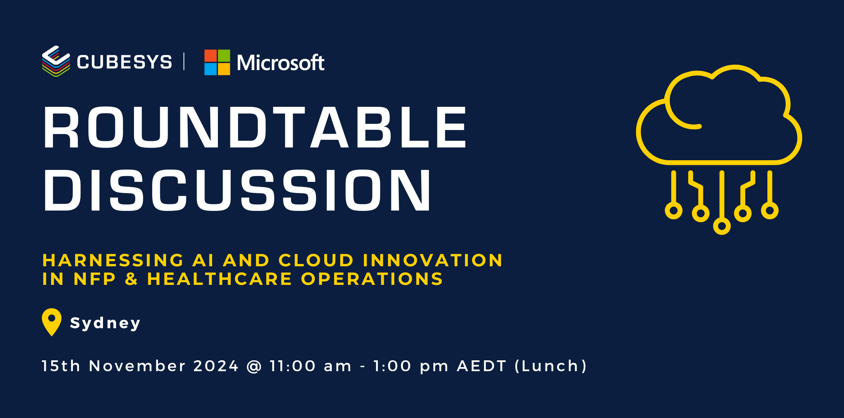
Notes:
Paul

Slide 2

I begin today by acknowledging the Traditional Custodians of the Gadigal land (online and offline) on which we meet today, and pay my respects to our Elders past and present.
Notes:
Paul

Slide 3

Agenda
Introductions
Setting the scene
Copilot
AI-Ready Infrastructure
Notes:
Paul

Slide 4

Introductions
Notes:
Paul

Slide 5
AI Journey
AI LEADER
Implementing AI
Developing
AI
Where are you today?
Where do you want to be tomorrow?
AI MATURITY
Considering
AI
Preparing for AI
AI READY
AI NEEDS
USING AI
BUILDING AI
Notes:
Paul

Slide 6
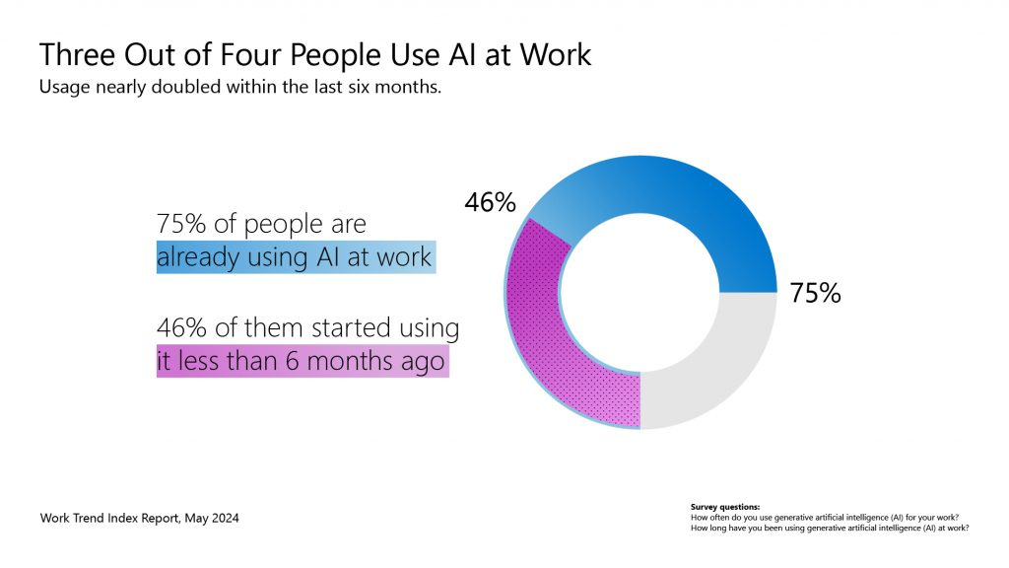
Notes:
Paul – Discuss Shadow AI … employee AI usage policy

Slide 7
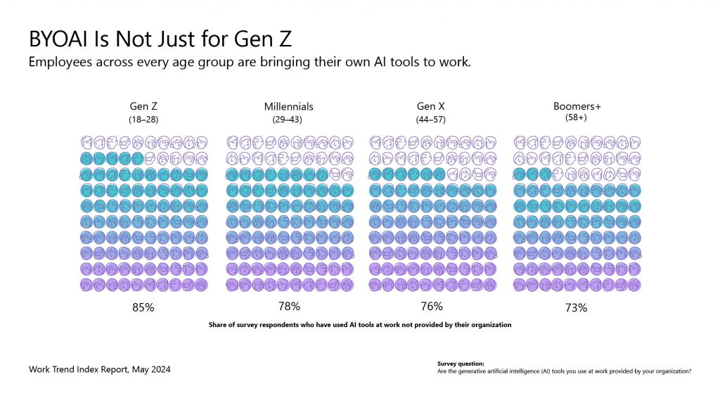
Notes:
Paul

Slide 8
Today’s NFP challenges (& opportunities)
Impactful Program Delivery
Engaged Supporters & Funders
Secure, Streamlined Operations
Capacity Constraints
Staffing Challenges
Donor retention
Personalized communication
Financial Stability
Burnout
Donor counts continue steep decline of 7.6% with new donors down 16.9% and newly retained donors down 18.7%. ³
77% of nonprofits believe personalizing donor communication is critical. ⁴
Roughly half of US-based nonprofits report being at risk financially. ⁵
71% of nonprofits had increased demands for their programs in 2023, resulting in waitlist increases and delays. ¹
74% of nonprofits reported job vacancies that they are having a difficult time filling. ²
Nonprofit workers report being stressed and burnt out. ⁶
¹ Forvis | ² National Council of Nonprofits | ³ AFP Global | ⁴ Twilio | ⁴ Independent Sector | ⁵ Candid | ⁶ Philanthropy.com
Notes:
Zeeshan
Let’s review some of the key challenges nonprofits are facing through the lens of program delivery, fundraising, and operations…
In this day & age, it’s all about doing more with less.

Slide 9
Expanded Use Cases for Generative AI
Business Needs
Increase
Productivity
Automate Process
Improve Customer Experience
Build Creative Content
Internal Virtual Assistant (Multimodal)
  Enterprise Conversational Knowledge Mining
  Custom Copilot
Developer Efficiency
  Code Generation and Documentation
Document Creation and Analysis
  Chart and Diagram Understanding and Analysis
  Q&A within a document
Business Analytics
  Business Intelligence
  Forecasting
  Social media trend analysis
Learning (incl. training EDU grading)
Workflow Management/RPA
Document Processing
  Report Summarization and Generation
  Document Classification/Scoring
  Claims Processing
Fraud, Security & Threat Detection
  Security and Threat Detection
  Video Surveillance
  Anomaly Detection
Digital Inspection & Comparison
  Defect Detection
  Inventory Management
Supply Chain Optimization
Compliance (incl. monitoring
and governance)
Personalized Customer Experience
  Conversational Knowledge Mining
  Custom Copilot
  Online Shopping Assistant
Intelligent Contact Center
  Agent Assistance
  Call Analytics
  Conversation Summarization
  Speech Analytics
  Speech Translation
  Conversational Knowledge Mining
Accessibility
  Day to Day interactions
  (image >text>speech)
  Shopping Experiences
  (image >text>speech)
  Audio Description
  (image >text>speech)
Marketing, Advertising & Sales Content Generation
Digital Asset Management
  Media and Entertainment
  Image Description
  Video Summarization
Personalized Content Generation
  Customer-facing Content Generation
  Personalized Recommendations
Product Design
& Development
Digital Art (including branded content)
Business Use Case – Technical Pattern
Notes:
Zeeshan
Copilot assists in crafting compelling fundraising emails, grant proposals, and donor thank-you notes. Personalize messages to strengthen donor relationships.

Slide 10
Key GenAI Use Cases by Function
CEO/Leadership
Board
Program Delivery
Fundraising
Create organization vision &
5-year planning documents
Provide data-driven insights for strategic planning
Crafting comprehensive policies across departments
Expediting compliance and auditing processes
Provide insightful, intuitive reporting across departments
Personalize communications to key stakeholders
Communicate policies and draft job descriptions
Create stunning training materials
Easily respond to beneficiary or staff emails
Have better donor conversations and boost
major gifts
Create donor presentations and proposals
Analyze donor data from previous quarters
Marketing
Operations & Finance
IT & Security
Volunteer Management
Identify relevant market trends and segments
Create the first draft for a campaign
Summarize campaign results with powerful visuals
Simplify financial reporting and planning
Identify performance improvements
Report metrics using
professional charts
Create a project plan for a product roll-out
Stay up to date on various project calls and chats
Identify patterns in data and solve issues faster
Effective volunteer community engagement and communications
Speed up volunteer recruitment
Streamline community training
Source: AI Nonprofits Research – Intentional Futures November 2023
Notes:
Copilot assists in crafting compelling fundraising emails, grant proposals, and donor thank-you notes. Personalize messages to strengthen donor relationships.
Education – Microsoft Adoption

Slide 11
Copilot
Notes:
Paul

Slide 12






Top 10 to "Try First"
with Microsoft 365 Copilot
Foundational skills for new users
1
2
3
4
5
Recap a meeting
– let Copilot keep track of key topics and action items so you can stay focused during the meeting and avoid listening to the recording after.
Summarize an
email thread
– get quickly caught up to a long, complex email thread.
Draft email
– personalize the tone and length.
Summarize a document
– get right down to business by summarizing long documents and focusing
on the relevant sections.
Tell me about a topic/project
– provide insights and analysis from across multiple sources to get up to speed quickly.
Draft an email to [name] that informs them that Project X is delayed two weeks. Make it short and casual in tone.
Draft an email with notes and action items from meeting
Click on the Summarize icon
Give me a bulleted list of key points from file
Tell me what's new about topic organized by emails, chats, and files?
6
7
8
9
10
Give me some ideas for …
– boost your creativity with ideas for your work such as agendas, product names, social media posts, etc.
Help me write …
– jumpstart creativity and write and edit like a pro by getting a first draft in seconds.
What did they say …
– when you vaguely remember someone mentioning a topic, have Copilot do the research.
How do I …
– let Copilot help you build or fix formulas in Excel.
Translate a message
– with business becoming increasingly international, it’s important to be able to read or write messages in other languages.
Suggest 10 compelling taglines based on file
Generate three ways to say [x]
What did person say about topic
How do I sum values that are greater than 0?
Translate the following text into French:
For more prompts, visit Copilot Lab at: aka.ms/CopilotLab
Notes:
Paul

Slide 13
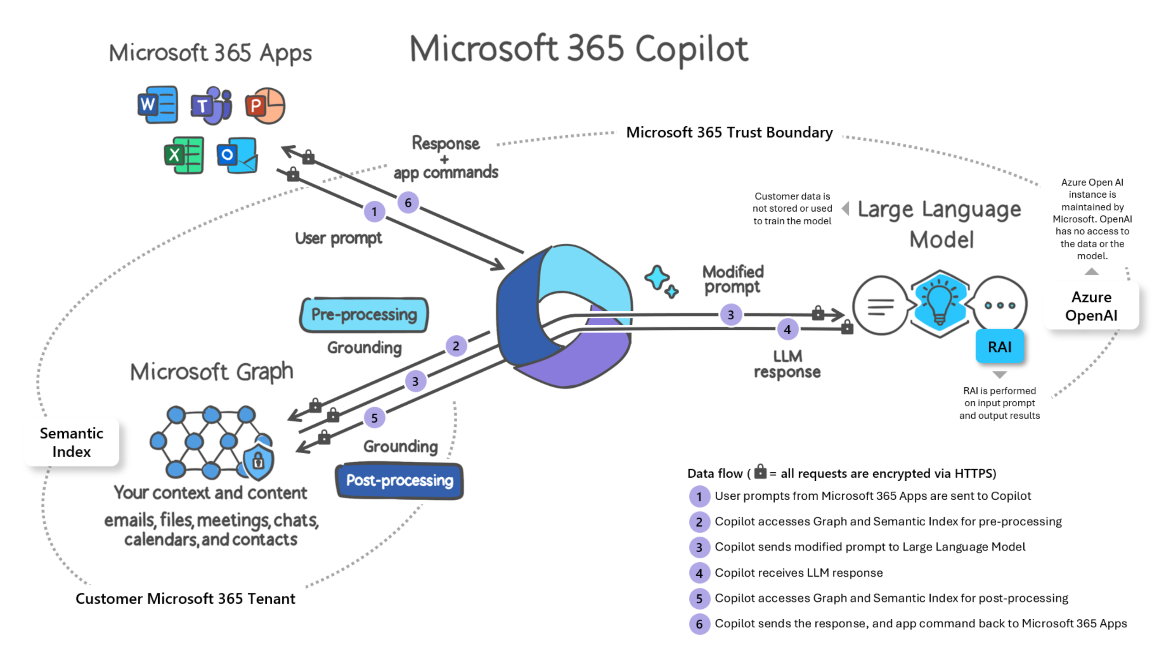
Notes:
Chris

Slide 14







Security concerns associated with AI usage
Visibility into the usage of AI applications can result in security and compliance challenges.
1
2
3
Data leak:
Users may inadvertently leak sensitive data to AI apps
Data oversharing:
Users may access sensitive data via
AI apps they are not authorized to view or edit
Non-compliance usage:
Users use AI apps to generate unethical or other high-risk content
Project x
COMPLIANT
Notes:
Chris

Slide 15



Start your AI data security journey …
Build a foundation for comprehensive data security
Discover sensitive data
Prevent data leak
Automate data labeling
Visit data classification and leverage built-in and custom Sensitive Information Types (SITs), trainable classifiers, and labeled content.
Create an endpoint DLP policy to prevent sensitive data exfiltration of sensitive information that is most critical to your organisation.
Define label taxonomy, enable default labels and protection and scale with auto-labeling on client application and services
Integrate seamlessly on a unified platform without dependency
Notes:
Chris

Slide 16

Common questions
1.
“How did Microsoft get AI Ready?”
2.
“How do I operationalize my AI solution?”
3.
“What is the baseline landing zone to get the AI solution running?"
4.
“How do I get my AI solution to safely access my data sources?”
5.
“What are the networking requirements for my AI solution?”
6.
“How do we migrate and secure our estate to enable AI at scale?”
about scaling
AI adoption
7.
“How do I secure my AI solution?”
8.
“How do I monitor the cost of the AI solution?”
9.
“What policies and protocols do I need to comply?”
Notes:
Zeeshan & Rick for rest of Deck …

Slide 17
Innovate with Azure AI Platform
Essentials for getting AI ready
security
Adopt financial best practices
Pricing
Skilling
Migrate and modernize workloads and data collocation
Platform landing zone
Manage
and
optimize
Readiness and foundation
Design
and govern
Trustworthy AI: security, privacy and transparency
Application landing zone
Architectural guidance
GenAIOps
Monitoring and security
Management and optimization
Architectural assessments and remediations
Notes:
Today, over 60,000 organizations across various industries are harnessing the power of Azure AI to drive innovation, improve operational efficiency, and unlock new business opportunities. From global brands like McDonald's and Volkswagen to industry leaders like PwC and Chanel, Azure AI is trusted by a diverse range of companies to deliver transformative solutions.

Slide 18




Shared responsibility model for AI adoption and operation
The shared responsibility between you and Microsoft depends on the chosen operating model
IaaS (BYO model)
PaaS (Azure AI)
SaaS (Copilot)
AI usage
User training, identity and access,
data security and governance
AI application
Plugins, design, infrastructure,
safety systems
AI platform
Model safety, accountability, tuning,
design, training data governance
Organization
Microsoft
Learn more: Shared Responsibility
Notes:
https://learn.microsoft.com/en-us/azure/security/fundamentals/shared-responsibility-ai

Slide 19





Readiness and Foundation
Five areas that will help you successfully scale AI adoption across your organization
1.
2.
3.
4.
5.
Data
collocation
Migrate infrastructure and collocate data and apps
Adopt financial best practices
Leverage FinOps to manage your AI spend
Pricing
Make pricing decisions with confidence
Platform Landing Zone
Pre-configured environment for efficient cloud management
Skilling
Empower individuals to successfully adopt AI
Notes:
Determine which workloads should leverage AI by examining use cases, reference architectures, and cost models that best support business objectives. Although data has always played a key role, its dimensions and use cases explode with possibilities in the era of genAI. Thus, a strong foundation of data management, engineering, and governance becomes a pre-requisite.
Organizations need to instill a cost-conscious mindset by understanding pricing and operating costs associated with architectural decisions of given workloads that employ LLMs and SLMs.
Pricing and forecasting consumption can be highly challenging, given that AI use cases are just beginning to emerge, and underlying capabilities continuously change.
Normal considerations for reliability, security, and efficiency have an added layer of ethics and governance concerns that require adaptations to operating models instantiated in a platform landing zone.
Adopting AI at scale also requires learning new skills and concepts that go beyond just learning to leverage AI in a workload. Teams need to understand how their roles and tasks will evolve as AI is introduced into their respective workstreams.
Migrate and Modernize:
Discover and assess workloads: Leverage Azure Migrate to discover and assess on-premises workloads, including servers, databases, and applications. This assessment will help identify workloads eligible for migration and provide recommendations for right-sizing and cost optimization.
Migrate workloads: Use Azure Migrate's migration tools, such as Azure Migrate: Server Migration and Azure Database Migration Service, to migrate eligible workloads to Azure. This ensures a secure and efficient migration process while minimizing downtime.
Modernize applications and data platforms: Modernize applications and data platforms to take advantage of cloud-native services and improve scalability, performance, and cost-efficiency. Leverage Azure App Service for web and mobile applications, Azure Kubernetes Service (AKS) for containerized applications, and Azure Cosmos DB for globally distributed, multi-model databases.
Establish platform landing zone: Establish a platform landing zone that Implement the Azure OpenAI Baseline Landing Zone reference architecture to establish a secure and well-architected foundation for AI workloads. This landing zone provides a baseline environment with pre-configured networking, identity, and security components, ensuring a consistent and compliant starting point for AI projects.

Slide 20





Design and Govern
Five areas that will help you design well-architected intelligent applications
1.
2.
3.
4.
5.
Responsible AI principles
Empowering responsible AI practices
Azure AI Content Safety
Guardrails for generative AI and controls for user-generated content
Data governance, security, privacy, and compliance
Deploy scalable architectures
that leverage
shared services
Architectural Guidance
Design with confidence
GenAIOps
Operationalize AI development with GenAIOps
Trustworthy AI

Slide 21



Manage and Optimize
Three components to continuously improve your deployed workloads
1.
2.
3.
Monitoring & security
Monitoring, logging, real-time evaluation, tracing, and debugging
Management and optimization
Bench marketing, sizing, and managing cost
Proactive resiliency & security for critical workloads
Periodic assessments of architecture aligned with business policies and capability tradeoffs
Notes:
Leverage native monitoring systems to manage and secure your AI workloads
Minimize hallucinations and other errors with prompt/response troubleshooting
Look for cost management and optimization opportunities as new pricing offers become available
Use security/reliability accelerators that take advantage of changes in the underlying cloud and AI platforms

Slide 22
Why Migrate to Cloud
Microsoft Cloud delivers desired outcomes
Maximize
ROI
Unmatched performance and resilience
Comprehensive code to cloud security
Be
AI ready
76%
5x
219%
284%
ction
savings over AWS¹
faster than AWS²
ROI on security³
ROI with Azure AI⁴
Reduce cost and complexity
Meet SLA’s
Secure end-to-end
Co-locate with AI services
Unified operations and management across hybrid and multicloud
Secure, develop, and operate infrastructure, applications, and Azure services anywhere
Cost Savings – Based on on-demand pricing and includes license and software assurance (SA), and extended security update costs for Windows Server and SQL Server with Azure Hybrid Benefit.
Microsoft Azure SQL Managed Instance benchmark vs. AWS RDS for SQL Server using Azure Hybrid Benefit pricing, May 2022. Comparison also shows that SQL runs up to 5x faster.
The Total Economic Impact ™ Of Microsoft Defender for Cloud” February 2021, commissioned by Microsoft. Organizations experience 219% ROI over three years.
Forrester Total Economic Impact™ of Microsoft Azure AI, April 2023
Forrester Total Economic Impact™ Of Microsoft Azure Arc for Security and Governance, August 2022. Organizations experience 206% ROI over three years.

Slide 23
Understanding migration and modernization
Applications | Data | Infrastructure
Migration (IaaS)
Drivers: Timelines, threats & business model
Modernization (PaaS/SaaS)
Drivers: Productivity, cost optimization & business insights
Expiring contracts, security/resilience/scalability &
CAPEX to OPEX
Application Innovations(TTM),
reduced resources and lock-in, data analytics (AI)
Move workloads “as-is”
Update the application stack
Azure on your terms

Slide 24
Paths to Azure
  Flexibility to move on your terms
Do-It-Yourself
Use Guidance
Leverage Partners
Azure Migrate
Third-party tools
  Well Architected Framework
  Cloud Adoption Framework
Azure Migrate and Modernize
Azure Innovate
FastTrack for Azure
Tools, guidance, and help to
move with confidence

Slide 25
